Slide 1
Leadership and Human Resources
Are we going in the right direction?

Slide 2
Objectives
What “Leadership” is – and what it isn’t!
What does “leading” really mean?
Why Leadership is important in the Organisation
Understanding where HR fits into the overall Leadership picture
Leadership in the HR function.

Slide 3
Describe and define the purpose of workplace coaching
What is “Leadership”?
Understand the context for effective workplace coaching

Slide 4
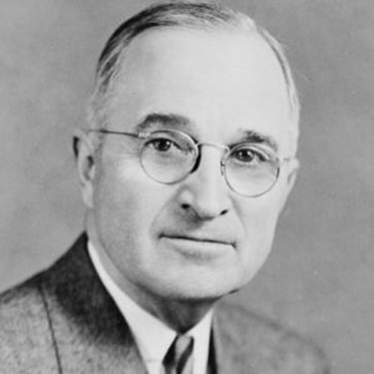
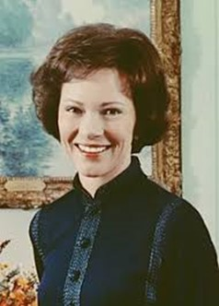
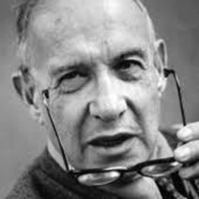
Leadership
“My definition of a Leader . . . is a man who can persuade people to do what they don’t want to do, or do what they’re too lazy to do, and like it.” (Harry S. Truman)
“Leadership occurs when one person induces others to work toward some predetermined objectives.” (Massie)
“A Manager takes people where they want to go. A great Leader takes people where they don’t necessarily want to go but ought to.” (Rosalyn Carter)
"The only definition of a Leader is someone who has followers.“ (Peter Drucker).

Slide 5
Prevalent Beliefs
Focus on “vision”
Seeking Alignment
Raising levels of Employee Engagement
Setting and monitoring Objectives
Creating Empowerment
(Bill Gates).

Slide 6
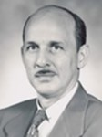
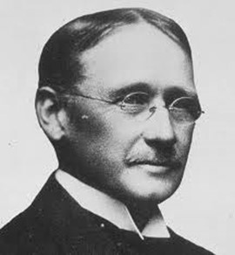
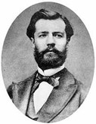
Management
Management is the art of getting things done through others and with formally organised groups (Harold Koontz)
Management is the art of knowing what you want to do then seeing that they do it in the best and cheapest manner (Fredrick Taylor)
Management is to forecast, to plan, to organise, to command, to coordinate and control the activities of others (Henri Fayol).
The organisation and coordination of the activities of a business in order to achieve defined objectives (The Business Dictionary).
Notes:
.

Slide 7
Leadership and Management
Is there a disconnect?
Can one exist without the other?
Is there a balance?
Or where should the main focus be?
What does good Leadership and Management look like?.

Slide 8
Reality
VUCA
Volatile-Unpredictable-Complex-Ambiguous
Need for organisational agility
Flatter structures
Less hierarchy
Distributed leadership
Survival!.

Slide 9
Why is Leadership important in Organisations?
Needs to harness and focus the ideas, skills, energy, and enthusiasm of the entire team for success
Importance of Line Managers (front line).
Art or process of influencing people to perform assigned tasks willingly, efficiently and competently
Vision
Mission
Direction

Slide 10
Where does HR fit into the overall Leadership picture??
People experts
Unique 360 degree perspective
Omnipresence
Essential infrastructure
Looking over the horizon.

Slide 11
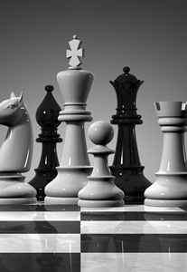
Leadership in the HR function
Balance of operational and strategic
Insight-driven
Courage to challenge the norm
Ethically focused
Brand risk aware
Coaching (Line Managers)
Step ON to the plate
Get there first!.

Slide 12
HR in the 21st Century
More than infrastructure
Much more than just being a “Business Partner”
Connecting beyond pure HR
Head of HR should know the organisation as well as the CEO
Agile and flexible
Making the Rules fit the Organisation
Looking to the Future – and future-proofing the Organisation.

Slide 13
HR in the 21st Century
Role-modelling
Vision
Visibility
Instinctive understanding of the organisational context
Assertive and bold
Stop asking for “permission”
Have the courage of your convictions
No longer just a support service.

Slide 14
HR in the 21st Century
Focus on the Important – and dump the Trivial
“Be there” for your People
Unleash the talent
Go for it – with all your Heart and Mind
Passion – not Position
And let your passion show
Have FUN!.

