Slide 1
Indicators of the Human Resources Enablers in the Federal Government
Federal Authority
May - 2018

Slide 2
Human Resources Law in the Federal Government
Human Resources Law in the
Federal Government:
Human Resources Law in the Federal Government was issued by virtue of the Federal Decree Law No. (11) of 2008 on human resources in the Federal Government as amended by Federal Decree Law No. (9) of 2011 and Federal Decree Law No. (17) of 2016 concerning the amendment of some provisions of the law of human resources in the Federal Government.
The law focuses on the human element as an investment asset that must be managed and developed effectively and efficiently. It also reflects the future vision and foresight of future needs for human resources, contributes to the development of regulations and policies within the work environment and contributes effectively to stimulate human development.
2

Slide 3

Human Resources Law Executive Regulations in Federal Government
The Executive rules comes within the endeavor of Government to develop a clear and effective standard in management of Government Human Resources and to develop the same, explain duties and rights of employees and Federal Government, provide suitable work environment for all employees therein, restructure procedures and laws of Human Resources in Federal Government and to launch its several initiatives and systems in this field to ensure response to its requirements and achieve its long range developmental objectives.
It includes all controls and details of the rights and duties of staff and recruitment processes and evaluation of human resources, systems of incentives and sanctions, vacations and other matters relating to human resources working in Federal Government agencies.
3

Slide 4

The Resolution of launching the Government Enablers Project
The Prime Minister Office has launched the Government Enablers Project of Strategic Course 2014/2016, including the following four perspectives; financial perspective, human resources perspective, smart government perspective and customers perspective.
Therefore, in October 14, 2014 the Federal Authority for Government Human Resources launched the Indicators of Human Resources Enablers, including five (5) strategic indicators and twelve (12) operational indicators. At the beginning of 2016, the Federal Authority for Government Human Resources has agreed with the Prime Minister Office to update these indicators as they shall include six (6) strategic indicators and two (2) operational indicators.
4

Slide 5
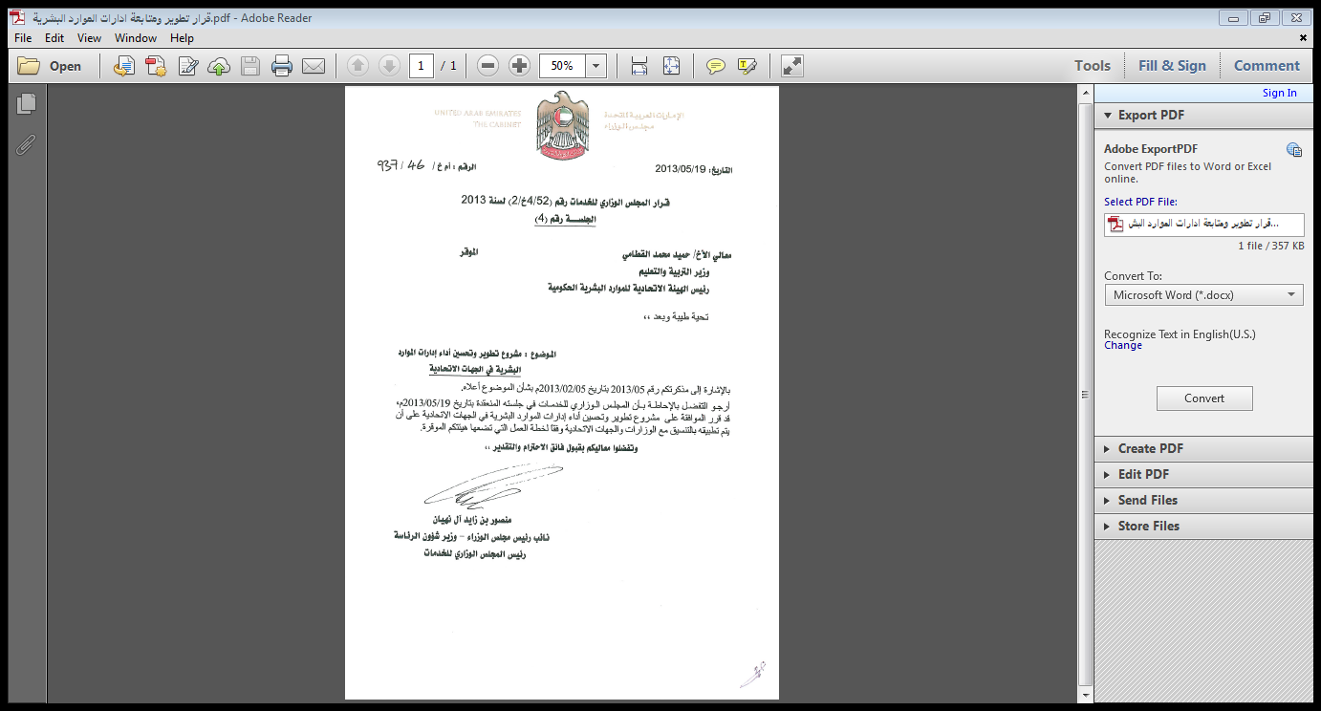
Decree-Law of the Performance Development and Improvement Project of Human Resource Departments in Federal Government
Pursuant to the Resolution issued by the Ministerial Development Council, (previously known as the Ministerial Council for Services) under No. (52/4KH/2) of 2013 in relation to approving the Performance Development and Improvement Project of Human Resources Departments in Federal Authorities in accordance with the balanced scorecard methodology conforming to the human resources indicators in Federal Government as the Federal Authority for Human Resources follows-up these indicators with the federal authorities by virtue of this resolution. The annual performance report of all federal authorities shall be also submitted to the Ministerial Development Council, (previously known as the Ministerial Council for Services).
5

Slide 6
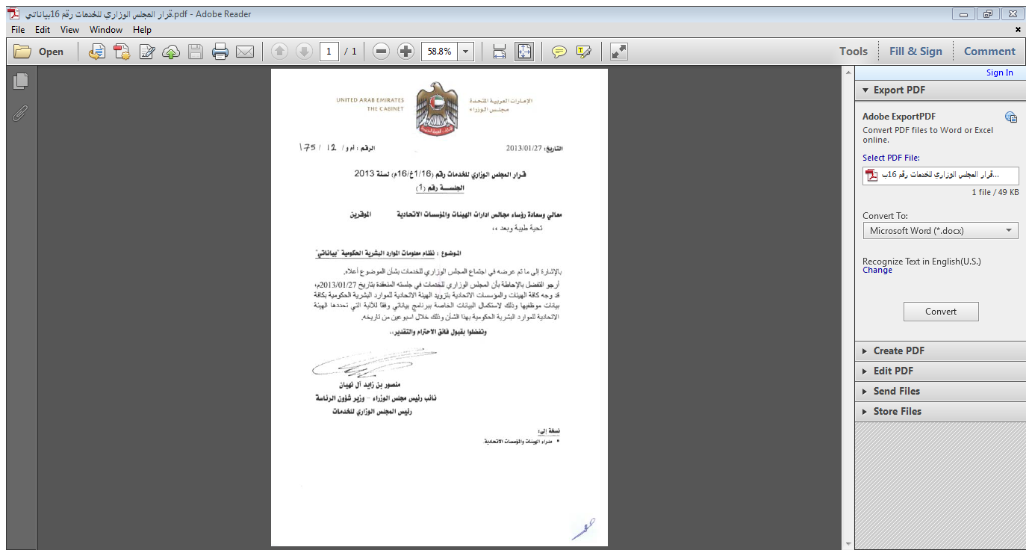
Bayanati System in the Federal Government
Pursuant to the Resolution issued by the Ministerial Development Council, (previously known as the Ministerial Council for Services) under No. (16/1KH/16) of 2013 which directed all Federal Entities to provide the Federal Authority for Government Human Resources with all data of its employees for the completion of data described in Bayanati Program in accordance with the mechanism determined by the Federal Authority for Government Human Resources in this regard.
6

Slide 7
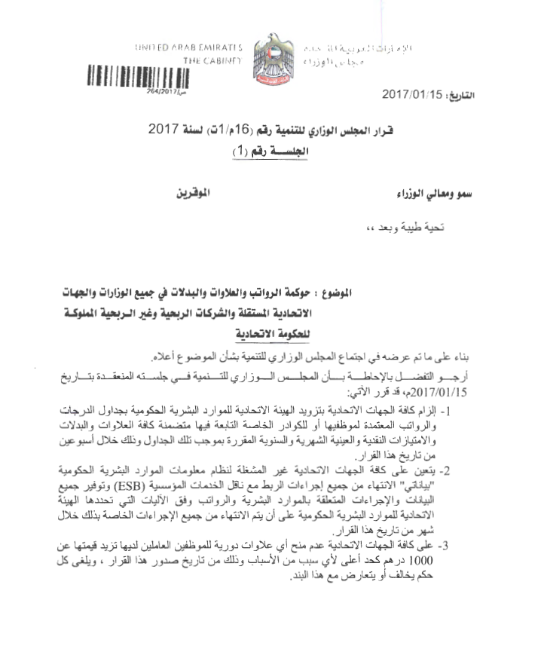
Resolution No. 16M / 1T of 2017 issued by the Ministerial Development Council
Pursuant to the Resolution No. 16M / 1T issued by the Ministerial Development Council in relation to the governance of salaries, bonuses and allowances in all ministries, independent and federal entities, profit and non-profit companies owned by the Federal Government, the Federal Authority for Government Human Resources is assigned to review the salaries schedule of the Federal Government and complete the electronic connectivity with the Independent Federal Entities via the enterprise service bus system, in addition to organizing the annual increments in Federal Government as they shall not exceed AED 1000.

Slide 8
Electronic Systems

Slide 9

UAE government performance management system (Adaa 2.0)
Adaa 2.0 Overview
Adaa 2.0 excels as a comprehensive electronic platform for supporting the decision-making process, because it provides officials with accurate details regarding rates of key achievements, goals, performance, programs and initiatives. In addition to the level of excellence of services provided, the system can monitor the competitiveness level of all ministries and federal agencies on a daily basis.
8

Slide 10


Bayanati System
Bayanati, a Human Resources Management Information System (HRMIS), is an electronic system through which all human resources procedures can be automated in all entities that operate this system, which constitutes a qualitative leap in the work of the federal agencies benefiting from this system. It provides automation for all human resources procedures, including financial and employee payroll procedures. It establishes a unified database in the Federal Government that covers all ministries and independent federal authorities.
9

Slide 11
Strategic Planning of Work-Force
Evaluated and described occupations ratio
Occupational turnover rate
Emiratisation rate
6%
73%
55%
45%
Occupational turnover rate at the entity
Government average
Described occupations rate
Undescribed occupations rate
Emiratisation rate achieved at the entity
Government average
Rate of Strategic Planning of Work-Force system activation
55%
55%
45%
Emiratisation rate.
Use of Human Resources Management Information System (Bayanati).
Occupational Performance management electronic system
Trainees rate
Training hours average
Knowledge Initiative
Occupations evaluation and description system.
Percentage of the total cost of employees from the budget of the entity
Rate of employee cost at the entity (monthly)
Sick leaves impact on the productivity.
Strategic Planning of Work-Force
Happiness, positivity, harmony and occupational loyalty in the Federal Government.
Rewards and Incentives System.
Emiratisation rate for years 2014-2017.
Operations
Learning and growth
Financial aspect
2014
2015
2016
2017
Customers

Slide 12
Occupational Performance system
Rate of Bayanati activation
Application of law and regulation
Emiratisation rate
The system was not used
The system was applied
Emiratisation rate achieved at the entity
Government average
Requires improvement
40%
The rate of electronic systems application for 2017
Obligatory
30%
Exceeds expectations
30%
The system was partially applied
Knowledge Initiative
Occupations evaluation and description system
Training hours average
Trainees rate
Number of implemented programmes through Qudarat (Capabilities) initiative
5 Training courses
Described occupations rate
Undescribed occupations rate
Emiratisation rate achieved at the entity
Government average
2017
55%
45%
2016
2015
Workforce Planning System
Sick leaves impact on the productivity
Rate of employee cost at the entity (monthly)
Rate of Total Number of Employees’ costs spent from the Entity’s Budget
Rate of Strategic Planning of Work-Force system activation
55%
2017
AED
2017
2016
AED
2016
2015
AED
2015
2015 2016 2017
Occupational turnover rate
Violations and grievances
Rewards and Incentives System
Job happiness rate
Occupational turnover rate at the entity
Government average
No. of honorees
9 violations
3 grievances
20 employees
2015 2016 2017

Slide 13
Data Sources and Results for Government Enablers Indicators - HR Aspect
Enterprise Service Bus
(ESB) in Bayanati
for connecting entities
Bayanati System for operating entities
The connectivity project has been launched with the federal authorities in 2015, whereas the data is read through a platform that gathers the data of the entity and inserts them into the Bayanati system to verify the results and their accuracy.
The results of human resources indicators are gathered through Bayanati system for all ministries and some independent entities that operate Bayanati systems. The Federal Authority For Government Human Resources is ready to provide Bayanati screens to any federal agency.
13

Slide 14
Workflow of gathering and approving the results of HR enablers
Collecting data according to Bayanati system
Entities
FAHR
FAHR
Receiving the replay from the entity within 3 days
There is a difference in results
Sending results to the entities for confirmation and auditing
Extracting the results from Bayanati system at the end of the measurement period
Yes
No
FAHR + Entities
Reviewing and approving results
Entering data into Adaa 2.0 System
Timetable:
Based on the above stages, the dates of results delivery were determined as follows:
At the second day of the month that follows the expiration of the measurement period, data will be extracted from Bayanati. For example, in relation to 30/06/2016 “End of the first half”, the data will be extracted on 2/7/2016.
These results are sent to the federal authorities on the 10th of the month following the expiration of the measurement period, i.e. in relation to the above example, this action will be taken on 10/07/2016.
A 3-days period is given to the authorities to respond to the Authority regarding the accuracy of the data.
The data will be entered into Adaa 2.0 system on 18/7/2016.
14

Slide 15

Emirates Award for Government Human Resources
Under the patronage of H.H. Sheikh Mansour bin Zayed Al Nahyan in relation to Emirates Award for Human resources, the Federal Authority for Human Resources shall follow-up the human resources indicators in all Federal Authorities in accordance with the award standards provided that they shall comply with the human resources indicators in Federal Government, which develops the human resources business and stimulates the Federal Entities to develop and improve the business field.
15

Slide 16
List of Indicators
S.N. | Name of Indicator | Type of Indicator
1 | Job happiness Rate * | Strategic / Enabler
2 | Positivity Rate in Work Environment * | Strategic / Enabler
3 | Occupational Harmonization Rate * | Strategic / Enabler
4 | Occupational Loyalty Rate * | Strategic / Enabler
5 | Female Leaders Rate in comparison with Total Number of Leaders | Strategic / Enabler
6 | Rate of Women working in the Specialized and Technical Categories in comparison with Total Number of Workers (including Male and Female Workers) of this Category | Strategic / Enabler
7 | Emiratisation Rate (Total) | Strategic / Enabler
8 | Impact of Leaves on the Employees' Productivity | Strategic / Enabler
9 | Training Hours Rate of Each Employee (Total) | Operational / Enabler
10 | Trainees Rate in comparison with Total Number of Employees | Operational / Enabler
11 | Impact of Training on Occupational Competencies | Operational / Enabler
12 | Occupational turnover rate | Operational
13 | Rate of Total Number of Employees’ costs spent from the Entity’s Budget | Operational
14 | Authority’s Employee Cost Rate | Operational
15 | Effective Use of Electronic and Smart Human Resources Systems | Operational
16 | Rate of Compliance with the Service Level Agreements (SLA) | Operational
17 | Rate of Compliance with the Final Occupational Performance Assessment Results (Adjustment and Balance) | Operational
18 | Strategic Planning of Work-Force | Operational
19 | Rate of Occupations described and approved in accordance with the Occupations Evaluation and Description System Mechanisms | Operational
20 | Rate of Employees honored in accordance with the Rewards and Incentives System | Operational
21 | Rate of Frequent Injuries resulting in the Time Waste. | Operational
22 | Violations Rate | Operational
23 | Rate of Adjudicated Grievances | Operational
*It shall be measured by the Prime Minister Office via the annual surveys.
16

Slide 17
Indicator No. 1: Job Happiness Rate
Type of Indicator: Strategic
Description of the Indicator:
•This indicator shall measure the employee’s happiness rate in work environment by making a quantitative study through an electronic questionnaire (happiness and positivity questionnaire in work environment) which shall be annually prepared by the Prime Minister Office.
•The scope of this indicator shall include employees of all occupational categories (such as leading, supervising, executive, specialized and technical categories including interface employees) excluding the senior leadership members (ministers, deputies, directors general and similar positions) and service occupations (employees, workers and similar positions).
• The occupational happiness rate shall be measured in the federal entity by asking 10 questions and these questions shall be also evaluated in accordance with a scale consisting of five (5) points (point No. 5 shall mean “strongly agree” and point No. 1 shall mean “strongly disagree“).
• The job happiness rate shall be calculated by calculating the rate of results no’s 4 “agree” and 5 “strongly agree” only in all questionnaire questions.
Method of Calculation:
Calculation Period | Calculation Unit | Calculation Type | Calculation Equation | Calculation Method | Source
Annually | Percentage | Increase is better. | Results of job happiness Questionnaire | Last Value | Report of Happiness and Positivity Study Results in Work Environment (prepared by the Prime Minister Office)
17

Slide 18
Indicator No. 2: Positivity Rate in Work Environment
Type of Indicator: Strategic
Description of the Indicator:
This indicator shall measure the extent of employee’s positivity and existence of a positive and supportive work environment, in addition to focus the organizational culture on the employee’s strengths, instead of weaknesses.
The Prime Minister Office shall annually measure this indicator by making the happiness and positivity questionnaire in work environment.
The scope of this indicator shall include employees of all occupational categories (such as leading, supervising, executive, specialized and technical categories including interface employees) excluding the senior leadership members (ministers, deputies, directors general and similar positions) and service occupations (workers and similar positions).
The positivity rate shall be measured in the federal entity by asking 7 questions and these questions shall be also evaluated in accordance with a scale consisting of five (5) points (point No. 5 shall mean “strongly agree” and point No. 1 shall mean “strongly disagree“).
The positivity rate shall be calculated in work environment by calculating the rate of results no’s 4 “agree” and 5 “strongly agree” only in all questionnaire questions.
Method of Calculation:
Calculation Period | Calculation Unit | Calculation Type | Calculation Equation | Calculation Method | Source
Annually | Percentage | Increase is better. | Results of Positivity Questionnaire in Work Environment | Last Value | Report of Happiness and Positivity Study Results in Work Environment (prepared by the Prime Minister Office)
18

Slide 19
Indicator No. 3: Occupational Harmonization Rate
Type of Indicator: Strategic
Description of the Indicator:
This indicator shall measure the employee’s harmonization rate, their interest in relation to both the work they joined and work place. It shall also measure the extent of the employee’s linkage to their occupations and relations with their co-workers and line managers in work environment.
The Prime Minister Office shall annually measure this indicator by making the happiness and positivity questionnaire in work environment.
The scope of this indicator shall include employees of all occupational categories (such as leading, supervising,
executive, specialized and technical categories including interface employees) excluding the senior leadership members (ministers, deputies, directors general and similar positions) and service occupations (employees, workers and similar positions).
This harmonization rate shall be measured in the federal entity by asking 12 (Gallup) questions about the occupation harmonization by assessing the employee’s impression towards (learning, growth and progress, whether the employees have friends in the work place, whether they feel that other employees’ work is excellent and of high quality, whether they believe in their entity’s mission and objectives, whether they feel that their opinions are important, what are their ideas about the development opportunities, whether they feel that others are concerned about them, whether they receive the appropriate appreciation in relation to their works, whether they have opportunity to often do excellent works, whether they receive support with adequate materials and devices and whether they perform their work below expectations).
These questions shall be also evaluated in accordance with a measurement consisting of five (5) points (point No. 5 shall mean “strongly agree” and point No. 1 shall mean “strongly disagree“)
The positivity rate shall be calculated in work environment by calculating the rate of results No. 5 “strongly agree” only in all questionnaire questions.
Method of Calculation:
Calculation Period | Calculation Unit | Calculation Type | Calculation Equation | Calculation Method | Source
Annually | Percentage | Increase is better. | Results of occupation Harmonization Questionnaire | Last Value | Report of Happiness and Positivity Study Results in Work Environment (prepared by the Prime Minister Office)
19

Slide 20
Indicator No. 4: Occupational Loyalty Rate
Type of Indicator: Strategic
Description of the Indicator:
This indicator shall measure the rate of employee’s loyalty towards his/her work place and the Prime Minister Office shall annually measure this indicator by making the happiness and positivity questionnaire in work environment.
The scope of this indicator shall include employees of all occupational categories (such as leading, supervising, executive, specialized and technical categories including interface employees) excluding the senior leadership members (ministers, deputies, directors general and similar positions) and service occupations (employees, workers and similar positions).
The occupational loyalty rate shall be measured by asking 2 questions (I feel proud of working for the entity, After the lapse of two years, I shall continue working in favor of the entity where I have already been working).
These questions shall be also evaluated in accordance with a scale consisting of five (5) points (point No. 5 shall mean “strongly agree” and point No. 1 shall mean “strongly disagree“)
The occupational loyalty rate shall be calculated by calculating the rate of results in relation to these two questions by adding the percentage of point No. 5 “strongly agree” to percentage of the point No. 4 “agree”.
Method of Calculation:
Calculation Period | Calculation Unit | Calculation Type | Calculation Equation | Calculation Method | Source
Annually | Percentage | Increase is better. | Results of Occupational Loyalty Questionnaire | Last Value | Report of Happiness and Positivity Study Results in Work Environment (prepared by the Prime Minister Office)
20

Slide 21
Indicator No. 5: Female Leaders Rate in comparison with Total Number of Leaders (Strategic)
Description of the Indicator
This indicator aims at reducing the gap between the male and female employees in the leadership positions, achieving the balance between two genders in the field of work and giving equal opportunities to them to participate in decision-making process.
The measurement of this indicator shall include all (male and female) employees in the leading category in accordance with the classification stipulated by the Prime Minister Office as mentioned below:
Category | Evaluation and Description System | Titles
Leadership | Senior Leadership | Minister, Deputy Minister, Director General, Assistant Deputy, Chief Executive Officer, Manager’s Representative, Secretary-General, President of Authority.
Method of Calculation:
Source | Equation | Calculation Type | Calculation Unit | Period
Bayanati | (Rate of Female Leaders / Rate of Total Number of Leaders in the Authority) * 100 | Increase is better. | Percentage | Annually
Denominator Components | Numerator Components
Total Number of Leaders | Number of Female Leaders
21

Slide 22
Indicator No. 6: Rate of Women working in the Specialized and Technical Categories in comparison with Total Number of Workers (including Male and Female Workers) of this Category (Strategic)
Description of the Indicator
This indicator aims at increasing the percentage of female employees in the specialized and professional occupations, achieving the balance between the two genders in the field of work and giving equal opportunities to them to participate in decision-making process.
The measurement of this indicator shall include all (male and female) employees in the specialized and professional categories
in accordance with the classification stipulated by the Prime Minister Office as mentioned below:
Category | Evaluation and Description System | Titles
Specialized and Professional | Technical and Professional | Senior Consultant, Consultant, Expert, Senior Specialist, Specialist, Physicians, Engineers, Analysts, Legal, Researchers, Auditors, Financial.
 | Technical support | Qualified and Technical Assistant of Healthy, Engineering, Maintenance, IT Fields.
Method of Calculation:
Source | Equation | Calculation Type | Calculation Unit | Period
Bayanati | (Number of Female Employees in the Specialized and Professional Occupations / Total Number of Employees in the Specialized and Professional Categories) * 100 | Increase of the Percentage of Female Employees. | Percentage | Annually
Denominator Components | Numerator Components
Total Number of Employees in the Specialized and Professional Categories | Number of Female Employees in the Specialized and Professional Occupations.
22

Slide 23
Indicator No. 7: Emiratisation Rate (Total)
Description of the Indicator:
• The indicator shall measure the modification of legislations and policies related to the development of national employees within the federal entities and the extent of their success in attracting and increasing the numbers of UAE national in the federal entity.
• The indicator shall also measure the emiratisation rate in the different occupational categories in a total manner and based on the detailed results of occupational categories, which shall give an indicator for the extent of emiratisation plan application which shall increase the emiratisation rate.
• The total Emiratisation rate is calculated at the Federal Government level (at the level of all occupational categories shown below) and for all types of contracts including private contracts, outsourcing contracts for natural persons that perform occupational tasks at the entity, part-time or temporary workers, and contracts of experts and consultants.
• The supporting category is excluded from the results of the indicator (Contracts of Rewards (Daily Workers Contracts)).
Note:
This indicator requires compliance with the detailed data of employees in the Human Resources Information Management System (Bayanati) according to the several titles approved in the Federal Government and their classifications.
The data of support category (including many occupations of which there are drivers, guards and correspondents) of all types of contracts, reward contracts, daily salary contracts despite they shall not be calculated in the emiratisation indicator) shall be required to be updated.
The following shall be excluded from the measurement of indicator: | The measurement of indicator shall include the following:
1) Support or Service Category. 2) Local Cadre. 3) Temporary or Part-Time Contracts. 4) Outsourcing Contracts. | 1) General and Specialized Cadre’s Employees such as Educational, Diplomatic, Medical and Judicial Cadres. 2) Employees appointed in accordance with the different full-time and special contracts, experts and consultants. 3) Secondment Employees 4) Employees in Extensive Summer Vacancy, Extensive Sick Leave, National Service 5) Employees in Probation Period
23

Slide 24
Indicator No. 7: Emiratisation Rate (Total)
Method of Calculation - Emiratisation Indicator:
Source | Equation | Calculation Type | Calculation Unit | Period
Bayanati System | (Number of Emirati Employees in the Approved Occupational Categories ÷ Total Number of Employees in the approved Occupational Categories at the end of Calculation Period) * 100 | Increase is better. | Percentage | Semi-Annually
Denominator Components | Numerator Components
Total Number of Employees at the end of Calculation Period. | Number of Emirati Employees at the end of Calculation Period.
Equation | Mid-Year
(Number of Emirati Employees in the Approved Occupational Categories at the End of First Mid-Year ÷ Total Number of Employees in the approved Occupational Categories at the End of First Mid-Year) * 100 | First
(Number of Emirati Employees in the Approved Occupational Categories at the end of the year ÷ Total Number of Employees in the different Occupational Categories at the end of the year) ×100 | Second
24

Slide 25
Indicator No. 8: Impact of Leaves on the Employees' Productivity
Description of the Indicator:
• This indicator shall measure the impact of leaves taken by the employees on their productivity as this indicator can be used by the HR Department to calculate absence cases and determine short-term absence cases or those requiring attention and thus the necessary actions shall be taken. It is also used as a method to measure the productivity by applying the following equation: Leaves Impact Factor = (A^2 * B).
A: Total Number of Employee's Recurrent Absence Cases per Year (Occurrence).
B: Total Number of Employee’s Absence Days per Year.
The results of Bradford Factor shall be classified as follows:
1) 125-0: The result does not require to file any comments.
2) 500-126: The result requires to file comments and control.
3) 1000-501: The result requires actions.
4) 2000-1001: The result requires to consider the application of disciplinary actions.
5) Higher than 2000: The result requires the application of strict disciplinary actions.
Types of Leaves included within the indicator scope: Sick Leaves, Sick Committee, Accompany Patient inside Country, Accompany Patient outside Country.
Types of Excluded Leaves: Annual Leaves, Exit Permission, Summer Vacancy, Performance of National Service and Mourning.
Note: The concerned team of Federal Authority for Human Resources shall extract this indicator from Bayanati System. In case the data of the entities are not available in Bayanati System, they shall be extracted from the Electronic Connectivity Systems (ESB).
25

Slide 26
Indicator No. 8: Impact of Leaves on the Employees' Productivity
Calculation Method of Sick Leaves Result Factor Affected Productivity:
Source | Equation | Calculation Type | Calculation Unit | Period
Bayanati System | (Number of Employees whose leaves impact factor is included in the 4th and 5th Classification requiring the Application of Disciplinary actions and Strict Disciplinary Actions ÷ Total Number of Employees in the approved Occupational Categories at the End of Calculation Period) × 100 | Decrease is better. | Percentage | Annually
Denominator Components | Numerator Components
Total Number of Employees in the approved Occupational Categories at the End of Calculation Period | Number of Employees whose leaves impact factor is included in the 4th and 5th Classification requiring the Application of Disciplinary actions and Strict Disciplinary Actions
26

Slide 27
Indicator No. 8: Impact of Leaves on the Employees' Productivity
Example of using Bradford Factor Points for the Calculation of Sick Leave Impact on Productivity in Bayanati System:
Table showing the distribution of sick leaves of employees in a federal entity, in accordance with the frequency of sick leaves and number of days:
Employment No. | Name of Ministry / Authority | Name of Employee | Type of Vacancy | Number of Leave Days | Start Date of Leave | End Date of Leave
1000001 | Federal Authority of Human Resources | Mohammed Ahmed Abdullah Khaled Hussein Salem | Sick Leave | 4 | 13-Jan-14 | 16-Jan-14
1000001 | Federal Authority of Human Resources | Mohammed Ahmed Abdullah Khaled Hussein Salem | Sick Leave | 3 | 20-Jan-14 | 22-Jan-14
1000001 | Federal Authority of Human Resources | Mohammed Ahmed Abdullah Khaled Hussein Salem | Sick Leave | 4 | 9-Feb-14 | 12-Feb-14
1000001 | Federal Authority of Human Resources | Mohammed Ahmed Abdullah Khaled Hussein Salem | Sick Leave | 2 | 2-Mar-14 | 3-Mar-14
1000001 | Federal Authority of Human Resources | Mohammed Ahmed Abdullah Khaled Hussein Salem | Sick Commission | 4 | 11-Aug-14 | 14-Aug-14
1000001 | Federal Authority of Human Resources | Mohammed Ahmed Abdullah Khaled Hussein Salem | Sick Commission | 12 | 27-Aug-14 | 13-Jan-14
Equation for the Calculation of Bradford Points
6*6*29 = 1.044 Bradford Factor Points for the Calculation of Sick Leave Impact
Frequency of Sick Leaves = 6
Total Number of Days = 29
Table showing factor index ratings for the calculation of sick leaves impact on productivity based on the employee’s results in accordance with the frequent sick leaves
Points Rating
Comments made in accordance with Point Results
0-125 | 1
126-500 | 2
501-1000 | 3
1001-2000 | 4
+2000 | 5
There are no comments about sick leaves.
Low Bradford Index: The employee has sick leaves which have no effects on productivity and no action is required.
Medium Bradford Index: The employee has sick leaves which have limited impact on productivity and this matter requires advices and directions issued to employees to ensure that his sick leave shall not be increased.
High Bradford Index: The employee has increased sick leaves which have significant impact on productivity and this matter requires measures to be taken to reduce the use of sick leaves.
Very High Bradford Index: The employee has several sick leaves which have high effect on productivity and this matter requires quick actions to be taken against employee.
27

Slide 28
Indicator No. 9: Training Hours Rate of Each Employee (Total)
Description of the Indicator:
• This indicator shall measure the participation levels of human resources in the training program, which shall improve their performance through the development of their knowledge, abilities and enable them to do so as per the occupation requirements.
• Total Number of Employees: The total Number of employees shall be calculated at the end of calculation period.
• The term of “Training Program” shall include each type of training either by attending a training seminar, program, workshop or the like whose time period shall not be less than two hours.
• The total Number of training hours received by all employees shall be calculated even if the names of employees are repeated as the objective of this indicator is to calculate the number of hours and compare them with the number of employees.
•The results shall be calculated including all occupational categories as of the 10th rank and above (wherever applicable).
Note:
This indicator shall be connected to another indicator, i.e. the trainees rate. Thus, the figures collected within both indicators shall be taken into consideration so as to ensure that there is no contradiction or conflict.
It is not necessary to train 100% of the workers at the entity, but this matter depends on many factors like the plan and budget of the training.
The concerned team of Federal Authority for Human Resources shall extract this indicator from Bayanati System. In case the data of the entities are not available in Bayanati System, they shall be extracted from the Electronic Connectivity Systems.
The following shall be excluded from the measurement of indicator: | The measurement of indicator shall include the following:
1) Support or Service Category. 2) Local Cadre. 3) Temporary or Part-Time Contracts. 4) Outsourcing Contracts. 5) Employees included in the ranks below 10th rank. 6) Secondment, Extensive Summer Vacancy, Extensive Sick Leave, National Service, Appointments done in the last quarter of year. 7) Resigned Employees during the Year. | 1) General and Specialized Cadre’s Employees such as Educational, Diplomatic, Medical and Judicial Cadres. 2) Employees appointed in accordance with the different full-time and special contracts, experts and consultants
28

Slide 29
Indicator No. 9: Training Hours Rate of Each Employee (Total)
Method of Training Hours Rate Calculation per Each Employee:
Source | Equation | Calculation Type | Calculation Unit | Period
Bayanati System | (Total Number of Actual Training Hours provided to the employees of the approved Occupational Categories during the Calculation Period ÷ Total Number of Employees targeted in the approved Occupational Categories at the end of Calculation Period) | Increase is better. | One Hour per Each Employee | Semi-Annually
Denominator Components | Numerator Components
Total Number of Employees targeted in the approved Occupational Categories at the end of Calculation Period | Total Number of Actual Training Hours provided to the employees of the approved Occupational Categories during the Calculation Period
Equation | Mid-Year
(Total Number of Actual Training Hours provided to the employees of the approved Occupational Categories in the First Mid- Year ÷ Total Number of Employees targeted in the approved Occupational Categories at the End of First Mid-Year) | First
(Total Number of Actual Training Hours provided to the employees of the approved Occupational Categories during the Year ÷ Total Number of Employees targeted in the approved Occupational Categories at the End of Year) | Second
29

Slide 30
Indicator No. 10: Trainees Rate in comparison with Total Number of Employees
Description of the Indicator:
This indicator shall measure the rate of trained employees of the federal entity.
• This indicator shall measure the participation levels of human resources in the training program, which shall improve their performance through the development of their knowledge, abilities and enable them to do so as per the occupation requirements.
• Total Number of Employees: The total last value shall be calculated at the end of calculation period.
• The term of “Training Program” shall include each type of training either by attending a training seminar, program, work shop or the like.
• The participation and attendance of employees in the training and development programs shall be calculated as one time, regardless of their frequent participation for more than one time as the objective is to measure the size of employee participation and not to measure the extent of their frequent participation.
The resigned employees shall be also excluded from the indicator result in both the numerator and denominator.
• The results shall be calculated including all occupational categories as of the 10th rank and above (wherever applicable).
Note:
This indicator shall be connected to another indicator, i.e. the training hours rate. Thus, the figures collected within both indicators shall be taken into consideration so as to ensure that there is no contradiction or conflict.
The concerned team of Federal Authority for Human Resources shall extract this indicator from Bayanati System. In case the data of authorities are not available in Bayanati System, they shall be extracted from the Electronic Connectivity Systems (ESB).
The following shall be excluded from the measurement of indicator: | The measurement of indicator shall include the following:
1) Support or Service Category. 2) Local Cadre. 3) Temporary, Daily Salary or Part-Time Contracts. 4) General Services Outsourcing Contracts. 5) Employees included in the ranks below 10th rank. 6) Secondment, Extensive Summer Vacancy, Extensive Sick Leave, National Service, Appointments done in the last quarter of year. 7) Resigned Employees during Year. | 1) General and Specialized Cadre’s Employees such as Educational, Diplomatic, Medical and Judicial Cadres. 2) Employees appointed in accordance with the different full- time and special contracts, experts and consultants
30

Slide 31
Indicator No. 10: Trainees Rate in comparison with Total Number of Employees
Method of Trainees Rate Calculation:
Source | Equation | Calculation Type | Calculation Unit | Period
Bayanati System | (Number of Employees within the Approved Occupational Categories who received Training during the Calculation Period (accumulative with no repeated frequency) ÷ Total Number of Employees planned to be trained in the approved Occupational Categories at the end of Calculation Period) × 100 | Increase is better. | Percentage | Semi-Annually
Denominator Components | Numerator Components
Total Number of Employees targeted in the approved Occupational Categories at the end of Calculation Period | Number of Employees within the Approved Occupational Categories who received Training during the Calculation Period (accumulative with no repeated frequency)
Equation | Mid-Year
Number of Employees within the Approved Occupational Categories who received Training during the Calculation Period (accumulative with no repeated frequency) during the First Mid-Year ÷ Total Number of Employees planned to be trained in the approved Occupational Categories in the First Mid-Year) × 100 | First
Number of Employees who received Training during the Year (with no repeated frequency) ÷ Total Number of Employees planned to be trained in the approved Occupational Categories at the End of Year × 100 | Second
31

Slide 32
Indicator No. 11: Impact of Training on Occupational Competencies
Description of the Indicator:
This indicator shall measure the outcome of implementing the training plan in federal entities by measuring the development of employee's competencies relating to the performance management system at the end of year (final stage of evaluation) without addressing the individual objectives.
Method of Calculation:
Source | Equation | Calculation Type | Calculation Unit | Period
Bayanati System | Total Number of Performance Levels Points Achieved in Competencies ÷ Total Number of Top Performance× 100 % | Increase is better. | Percentage | Annually
Denominator Components | Numerator Components
Total Number of Top Performance Levels Points in Competencies | Total Number of Performance Levels Points Achieved in Competencies
32

Slide 33
Indicator No. 11: Impact of Training on Occupational Competencies *
Total Number of Top Performance Level Points in Competencies
Results of Evaluation | Competencies 6 | Competencies 9
4 significantly exceeds the expectations. | == | ==
3 exceeds the expectations. | 24 | 36
2 meets the expectations. | 18 | 27
1 requires to be improved | 12 | 18
Explanatory Example:
The total Number of performance levels points achieved in the competencies of employee based on the (6) competencies for the year of 2016 was 11, i.e. it reached the level (2) meeting the expectations. To apply the equation of training impact measurement affected the competencies, the following shall be done:
11 ÷ 18 × 100 = 61%
The total Number of performance levels points achieved in the competencies of employee based on the (6) competencies for the year of 2017 reached 15, i.e. it still within the second level meeting the expectations:
15 ÷ 18 × 100 = 86%
Based on the following, the employee achieved a development in the level of occupational competencies as the training return rate reached 86% in 2017 in comparison with the year of 2016 as it reached 61%.
*This indicator shall measure the results of competencies only, but it shall not measure the result of individual objectives.

Slide 34
Indicator No. 12: Occupational Turnover Rate
Description of the Indicator:
The occupation turnover rate shall measure the federal entity’s efforts relating to retaining the employees as it shall reflect their satisfaction about the same, occupation leave rate and escape of competencies in the Federal Government either through voluntary termination of service such as resignation or as a compulsory termination of service such as dismissal or transfer outside the authority.
Note:
- The occupation turnover indicator shall require the expiration of notice period of resigned employee to be calculated within the indicator. For example; the date of July 01, 2015 is determined to be the last day of employee, thus the employee shall be calculated in the occupation turnover indicator “second mid-year”, but he shall not be calculated as of the date of resignation request and it shall exclude the notice period exclusions by virtue of a decision issued by the president of the federal entity.
- The concerned team of Federal Authority for Human Resources shall extract this indicator from Bayanati System. In case the data of the entities are not available in Bayanati System, they shall be extracted from the Electronic Connectivity Systems.
The following shall be excluded from the measurement of indicator: | The measurement of indicator shall include the following:
1) Local Cadre. 2) Temporary, Daily Salary or Part-Time Contracts. 3) General Services Outsourcing Contracts. 4) Reach the Retirement Age 5) Death Cases | 1) General and Specialized Cadre’s Employees such as Educational, Diplomatic, Medical and Judicial Cadres. 2) Employees appointed in accordance with the different full-time and special contracts, experts and consultants. 3) Secondment Employees 4) Employees in Extensive Summer Vacancy, Extensive Sick Leave, National Service 5) Employees in Probation Period 6) Support or Service Category.
34

Slide 35
Indicator No. 12: Occupational Turnover Rate
Method of Occupation Turnover Rate Calculation:
Source | Equation | Calculation Type | Calculation Unit | Period
Bayanati System | Number of Employees who leave the service / Total Number of Actual Employees × 100 | Decrease is better. | Percentage | Semi-Annually
Denominator Components | Numerator Components
Total Number of Actual Employees | Number of Employees who leave the Service at the End of Year
35

Slide 36
Indicator No. 13: Rate of Total Number of Employees’ costs spent from the Entity’s Budget
Description of the Indicator
This indicator shall calculate the productivity costs rate of human capital in the federal entities in comparison with the total number of employee as the rate of financial costs spent from the entity’s budget to the employees shall be also calculated.
The following shall be excluded from the measurement of indicator:
The expenses related to the entity’s basic activities which have no direct relation with the employee’s costs (social relieves, scholarships and the like).
Method of Calculation:
Source | Equation | Calculation Type | Calculation Unit | Period
Entity's Budget | Costs of Total Number of Employees ÷ Total Expenses × 100 | Decrease is better. | Percentage | Annually
Denominator Components | Numerator Components
Total Expenses (Without the Projects Item) | Costs of Total Number of Employees
36

Slide 37
Indicator No. 14: Authority’s Employee Cost Rate
Description of the Indicator:
This indicator shall measure the average employee’s costs rate in the federal entity as the general rate shall be calculated; for the costs of each employee, by the budget allocated to the entity’s employees.
Method of Calculation:
Source | Equation | Calculation Type | Calculation Unit | Period
Entity's Budget | Costs of Total Number of Employees ÷ Total Number of Employees at the End of Calculation Period | Decrease is better. | Percentage | Annually
Denominator Components | Numerator Components
Total Number of Employees at the End of Calculation Period | Costs of Total Number of Employees
37

Slide 38
Indicator No. 15: Effective Use of Electronic and Smart Human Resources Systems
Description of the Indicator:
The indicator shall measure the effective use of electronic and smart human resources systems including the following:
Human Resources Procedures System Wages and Salaries System Statistical Reports System Occupational Performance Management System Electronic Training and Development System Smart Applications System | Electronic Approvals System Smart Reports System Human Resources Systems Automation Electronic Organizational Structures Self-Services Electronic Recruitment | Attendance and Leave System Support Service Office System Workforce Planning System Electronic Connectivity System of Human Resources Databases (ESB) Electronic Archiving System of Human Resources Procedures
Method of Calculation:
Source | Equation | Calculation Type | Calculation Unit | Period
Bayanati System for operating entities Enterprise Service Bus system (ESB) for non- operating entities of Bayanati System | (Number of the transaction carried-Out via Electronic and Smart Systems ÷ Total Number of Employees) × 100 | Increase is better. | Percentage | Annually
Denominator Components | Numerator Components
Total Number of Employees | Number of transactions carried-out via Electronic and Smart Systems.
38

Slide 39
Indicator No. 16: Rate of Compliance with the Service Level Agreements (SLA)
Description of the Indicator:
This indicator aims at measuring the services effectiveness and efficiency levels provided by the human resources departments in the authorities to their employees, other departments and units, as well as customers.
Method of Calculation:
The method of measurement shall depend on the determination of rate of services achieved on the ideal time and expected in accordance with the reference list of certain human resources department services determined by the Federal Authority for Government Human Resources.
Source | Equation | Calculation Type | Calculation Unit | Period
Bayanati System for operating entities Enterprise Service Bus system (ESB) for non- operating entities | (Total rates of compliance with certain time-frames of the entity’s human resources services ÷ Total number of the Human Resources Department services) × 100 | Increase is better. | Percentage | Annually
Denominator Components | Numerator Components
Total number of Human Resources Department’s services. | Total rates of compliance with certain time-frames of entity’s human resources services
39

Slide 40
Indicator No. 16: Rate of Compliance with the Service Level Agreements (SLA)
S.N. | Service Level Agreement Description: Employee’s Human Resources Department | Working Days
 |  | Excellent | Satisfactory | Requires Improvement
1 | Time taken to complete the salaries requests/service letters | 2 or less | 3 to 5 | 6 or more
2 | Time taken to complete the annual/sick leaves requests. | 2 or less | 3 to 5 | 6 or more
3 | Time taken to complete the requests of modifying the attendance and leave hours. | 2 or less | 3 to 5 | 6 or more
4 | Time taken to complete the tuitions payment requests. | 2 or less | 3 to 5 | 6 or more
5 | Time taken to complete the annual tickets requests. | 2 or less | 3 to 5 | 6 or more
6 | Time taken to amend/renew contract. | 2 or less | 3 to 5 | 6 or more
7 | Time taken to complete the visas renewal requests. | 2 or less | 3 to 5 | 6 or more
Explanatory Example:
Explanatory Example: Some services provided by the Human Resources Department in the federal entities, in addition to the times which shall be implemented by the Human Resources Departments to achieve the excellence of services.
40

Slide 41
Indicator No. 17: Rate of Compliance with the Final Job Performance Assessment Results (Adjustment and Balance)
Description of the Indicator:
This indicator shall measure the rate of compliance of the Federal and government ministries and entities with the adjustment and balance rates as a significant condition of the performance management system approved by the government.
Standards of the Final Job Performance Assessment:
4= Significantly exceeds expectations (0% -5%)
3= Exceeds expectations (0% -10%)
2= Meets expectations (80% -100%)
1= Needs improvement (0% -5%)
Note
The concerned team of the Federal Authority for Human Resources shall extract this indicator from Bayanati System. In case the data of entities are not available in Bayanati System, they shall be extracted from the Electronic Connectivity Systems.
41

Slide 42
Indicator No. 17: Rate of Compliance with the Final Job Performance Assessment Results (Adjustment and Balance)
Measurements method of rate of Compliance with the Final Job Performance Assessment Results (Adjustment and Balance):
Source | Equation | Calculation Type | Calculation Unit | Period
Bayanati System for operating entities Organizational Services Transfer System (ESB) of Non-Operating Entities | Number of employees (In each standard) ÷ Total number of assessed employees. | Achieve the determined adjustment rates | Percentage | Annually
Denominator components | Numerator components *
Total number of assessed employees | Number of employees (In each standard) Number of employees whose assessment significantly exceeds expectations Number of employees whose assessment exceeds expectations Number of employees whose assessment meets expectations Number of employees whose assessment needs improvement
Note :
The numerator components may differ in accordance with the measurement used in the Federal entity (triple, quadruple, quintuple)
42

Slide 43
Indicator No. 18: Strategic Planning of Work-Force
Description of the Indicator:
This indicator shall measure the compliance rate of the Federal entities regarding the work-force plan based on the work-force planning guide/system prepared by the entity and the extent of connecting this planning to the electronic system of work-force planning connected to Bayanati system and salaries system to measure the extent of adaptation with the work-force planning terms*
This indicator shall also serve the Government’s directions issued in relation with the active planning of human capital to increase productivity level in the Federal Government as it shall help to determine the future expectations of necessary occupations and competencies, which shall improve the attraction and development processes.
Note
The concerned team of the Federal Authority for Human Resources shall extract this indicator from Bayanati System. In case the data of entities are not available in Bayanati System, they shall be extracted from the Electronic Connectivity Systems.
*The strategic planning guide of the human resources shall be available on the Authoritie’s website and the team of the Federal Authority for Government Human Resources shall be completely ready to support the Federal entities for the application of this guide, www.fahr.gov.ae
43

Slide 44
Indicator No. 18: Strategic Planning of Work-Force
Measurement method of compliance rate with the application of Work-Force Planning Stages:
Source | Equation | Calculation Type | Calculation Unit | Period
Bayanati System for operating entities Organizational Services Transfer System (ESB) of Non-Operating entities | Number of occupations at the Final Stage, i.e. the occupations for which the determination process of their attraction and retaining priorities is completed ÷ Total number of occupations ×100 | Increase is better | Percentage | Annually
Denominator components | Numerator components
Total number of entity’s occupations (With no frequency) | Number of occupations at the final stage, i.e. the occupations for which the determination process of their attraction and retaining priorities is completed
44

Slide 45
Indicator No. 19: Rate of Occupations described and approved in accordance with the Occupations Evaluation and Description
System Mechanisms
Description of the Indicator:
This indicator shall measure the rate of occupations whose descriptions are developed or updated as the measurement process aims at following-up the occupations evaluation and description process at the level of the Federal Government. The occupations categorization and evaluation shall be based on the mechanism and system issued by the Federal Authority for Government Human Resources. The total number of approved occupations in the occupations categorization and evaluation system (the approved plan) shall be determined.
Method of Calculation:
Source | Equation | Calculation Type | Calculation Unit | Period
Bayanati System for operating entities Organizational Services Transfer System (ESB) of Non-Operating Authorities | (Total number of occupations described and approved by the committee ÷ Total number of occupations determined within the scope of occupation evaluation and description system) × 100 | Increase is better | Percentage | Annually
Denominator components | Numerator components
Total number of occupations (With no frequency) determined within the scope of Occupations Evaluation and Description System | Total Number of occupations described and approved by the committee
45

Slide 46
Indicator No. 20: Rate of Employees honored in accordance with the Rewards and Incentives System
Description of the Indicator:
The system is aiming at increasing the Federal Government’s competitiveness to be an attractive environment of national competencies through granting the rewards and incentives to the Federal Government’s employees within an integrated system of the human resources systems and legislations in the Federal Government, initiatives and stimulation programs, which promote the performance, increase the productivity and ensure the happiness of both employees and customers.
Note
The rewards and incentives system shall be applied on the Federal Government’s employees in accordance with the Cabinet Resolution No. (18) of 2015 and the system guide is available on the website of the Federal Authority for Government Human Resources to deduce the methods of application www.fahr.gov.ae
Method of Calculation:
Source | Equation | Calculation Type | Calculation Unit | Period
The Federal Entity | Total number of employees honored by the entity ÷Total number of employees ×100 | Increase is better | Percentage | Annually
Denominator components | Numerator components
Total number of empployees | The number of employees honored by the entity
46

Slide 47
Indicator No. 21: Rate of Frequent Injuries Causing Time Waste.
Description of the Indicator:
This indicator aims at increasing the levels of occupational health and safety at work sites (the office work environment) by supporting the Federal ministries and entities to take the necessary actions for the purpose of creating a healthy and safe work environment to ensure the safety of both the employees and customers in accordance with the highest levels of occupational health and safety in work environment.
The indicator shall be divided into two parts:
Frequency rate of work-related injuries
Severity extent of the injuries
Method of Calculation:
Frequency rate of work-related injuries
Source | Equation | Calculation Type | Calculation Unit | Period
The Federal Entity | Number of work injury accidents / Total number of entity’s working hours × 1,000,000 | Decrease is better | Percentage | Annually
Severity extent of the injury
Source | Equation | Calculation Type | Calculation Unit | Period
The Federal Entity | Number of working hours wasted for Each Accident / Total number of entity’s working hours × 1,000,000 | Decrease is better | Percentage | Annually
47

Slide 48
Indicator No. 21: Rate of Frequent Injuries resulting in the Time Waste.
Explanatory example of the extracting methods of the entity’s total working hours:
Each entity has its own work nature, thus the total working hours shall differ from one entity to another due to the difference of work nature and the total number of employees. In order to extract the total working hours, the following shall be done:
The number of working days in the calendar year is 224
The number of daily working hours is 7 hours
224 × 7 = 1,568
1,568
5,000
= 7,840,000
The total number of working hours
Number of hours
Number of employees
Explanatory example of the extending methods of the entity’s total working hours wasted for each entity’s accident:
The number of waste working hours:
196 = 7 × 28
The number of working hours wasted in the entity is 196
Total number of absence days for all employees | Absence days | Number of injured employees | Number of accidents
6 | 3 | 2 | 1
10 | 2 | 5 | 2
12 | 4 | 3 | 3
28 | Total
The number of daily working hours
48

Slide 49
Indicator No. 22: Violations Rate
Description of the Indicator:
This indicator shall measure the number of violations approved and documented in the entity by the violation committees via Bayanati Screens or any other electronic system.
Method of Calculation:
Source | Equation | Calculation Type | Calculation Unit | Period
Bayanati System for operating entities Organizational Services Transfer System (ESB) of Non-Operating Authorities | Number of violations recorded in the system ÷ Total number of employees at the end of calculation period × 100 | Decrease is better | Percentage | Annually
Denominator components | Numerator components
Total number of employees at the end of the calculation period | The number of violations recorded in the system
49

Slide 50
Indicator No. 23: Rate of Adjudicated Grievances
Description of the Indicator
This indicator shall measure the number of grievances submitted by the employees in the entities through the grievances committees and documented via Bayanati Screens or any other electronic system.
Method of Calculation:
Source | Equation | Calculation Type | Calculation Unit | Period
Bayanati System for operating entities Organizational Services Transfer System (ESB) of Non-Operating Authorities | Number of adjudicated Grievances ÷ Total number of grievances recorded in the entity’s system × 100 | Increase is better | Percentage | Annually
Denominator components | * Numerator components
Total number of grievances at the entity | Number of adjudicated Grievances
50

Slide 51



Contact Details
Team Work of the Indicators of the Federal Authority for Government Human Resources:
042319043 | Section Head, Government Planning & Development | frashed@fahr.gov.ae | Fatma Abdullah Rashed
04-2319168 | Senior Executive, Performance Indicators and Follow-up | ZAlAli@fahr.gov.ae | Zeinab Al Ali
04231 9118 | Senior Executive of Institutional Performance | OAlBalooshi@fahr.gov.ae | Omar Al Balooshi
04 2319120 | Director of Performance Evaluation and Follow-up Management System | zalbaadani@fahr.gov.ae | Zayed Al Qahtani
Twitter:https://twitter.com/FAHR_UAE
Youtube: http://www.youtube.com/user/FAHR2011
Instagram: FAHR_UAE
Abu Dhabi: P. O. Box: 2350 Phone No.: +971 2 - 4036000 Fax No.: +971 × 2 - 6266767
Dubai: P. O. Box: 5002 Phone No.: +971 4 - 2319000 Fax No.: +971 × 4 - 2941216
Website: www.fahr.gov.ae Authority’s e-mail: info@fahr.gov.ae
51

